Slide 1

eXecutable-Only-Memory-Switch (XOM-Switch) Hiding Your Code From Advanced Code Reuse Attacks in One Shot
Mingwei Zhang, Ravi Sahita (Intel Labs) Daiping Liu (University of Delaware)

Slide 2



[Short BIO of Speaker]
Mingwei Zhang is currently a research scientist in Anti-Malware Team in Intel Labs.
His current research areas span a wide range of topics including program hardening using Intel hardware features, anti-malware techniques, dynamic sandboxing for Android and etc. Mingwei received his Ph.D of computer science from Stony Brook University in 2015. His research in the Ph.D program was focused on software security protection via binary rewriting and program analysis.
https://www.linkedin.com/in/mingwayzhang
https://scholar.google.com/citations?user=llCSAtwAAAAJ&hl=en
http://www3.cs.stonybrook.edu/~mizhang/

Slide 3
Agenda
Problem Statement and Motivation
Intel’s protection keys design and implementation.
Binary rewriting in program loader
Evaluation
Conclusion

Slide 4
Code Reuse Attacks
Effective way to bypass DEP, i.e., executing code without code injection.
Code reuse attacks requires accurate locations of “gadgets”, which may
Suffer from code diversity and availability.
Advanced Code Reuse Attacks.
Designed to solve the problem of gadget availability

Slide 5
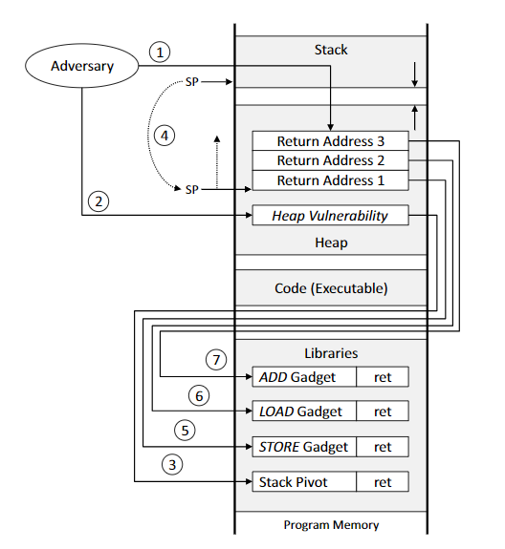


1st ROP harvest code pages
2st ROP launch real attack
0101001110101110
Traditional Code Reuse Attacks
Just-In-Time Code Reuse Attacks
Blind Code Reuse Attacks

Slide 6
Reason of Advanced ROP:
Convenience:
Robustness of attacks on binaries in many versions.
Robustness on defenses like fine grained code randomizations.
Larger attack vector:
Both JIT-ROP and BROP makes significant threat to close-source/private-distribute binaries.
Advanced ROP attacks require code reading capability. This is why defenses on eXecutable Only Memory.

Slide 7
Prevention on advanced code reuse focuses on eXecutable Only Memory.
Using page fault handler: XnR (CCS ’14)
Using Extended Page Table: X^R
Using side effects in micro-architecture: HideM
Using hardware support in ARM: NORAX
They are all beautiful, but they have their own drawbacks☺
High runtime overhead.
Require Hypervisor support (nested virtualization in cloud?)
Significant effort on Code Refactoring/Rewriting/Recompilation.
Not available on x86 architecture (not available for cloud apps)
eXecutable Only Memory could be easily achieved using new Intel hardware capability

Slide 8
Intel Protection Keys

Slide 9
Memory Protection Keys (MPK)
“Intel's memory protection keys feature works by making use of four page-table bits to assign one of sixteen key values to each page. A separate register then allows the assertion of ‘write-disable’ and ‘access-disable’ bits for each key value. Setting the write-disable bit for key seven, for example, will cause all pages marked with that key as being read-only, even if the protection bits on those pages would otherwise allow write access. The write- and access-disable bits are local to each thread, and they can be modified without privilege. Since keys are assigned to pages in the page-table entries, only the kernel can change those.”
[LWN: https://lwn.net/Articles/643797/]
Memory protection keys is described in Intel® 64 and IA-32 Architectures Software Developer’s Manual [Volume 3A]
TL;DR ?

Slide 10
What is Intel’s MPK?
Protection Keys. [section 4.6.2 in Intel SDM]
Tagging memory pages with extra permission bits.
Properties?
Fast permission switches of user level pages.
Allows pages to be “read-only” or “inaccessible”.
Support 16 memory domains per process.

Slide 11
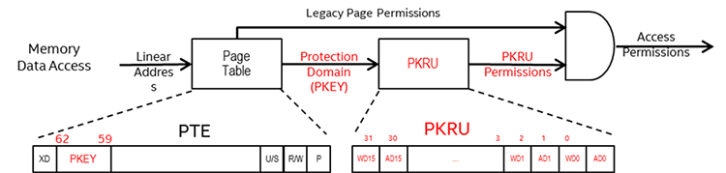
Access permission is decided jointly by page permission & Protection Keys permission
pkey bits are used as an “index” to PKRU and each has two bits.
pkey applies to only user level pages (U/S=1)
Supervisor accesses subject to the same checks as user accesses
If pkey denies access, direct memory accesses from kernel are also rejected.
Notes:
https://software.intel.com/en-us/articles/intel-xeon-processor-scalable-family-technical-overview

Slide 12
Primitives: 3 new syscalls and 2 new instructions added:
New Syscall: int pkey_alloc(unsigned long flags, unsigned long initial_rights);
New Syscall: int pkey_mprotect(void *start, size_t len, int prot, int pkey);
New Syscall: int pkey_free(int key);
New Insn: wrpkru /* change memory permission of pages that bind to a pkey. */
New Insn: rdpkru /* get the memory permission of a pkey */

Slide 13
Turned on for each process.
16 keys per process
Each key could bind to a large number of non-contiguous memory regions.
Permission change by one instruction “wrpkru”
Permission is per-thread based.
Permission by pkey
(thread #1)
Permission by
mmap/mprotect
Unintended/malicious read/write
Permission by pkey
(thread #2)
None
rw
r
Pkey #1 (thread #1)
None
rw
r
Disable write
Pkey #1 (thread #2)
None
rw
r
DRAM
Performance: 60 ~ 120 cycles for wrpkru. Almost no relevance to memory range size. In compare, one “mprotect” could cause 20,000 cycles.
Intel CPU
PKRU (thread #1)
PKRU (thread #2)

Slide 14
void main()
{
int real_prot = PROT_READ | PROT_WRITE;
int pkey = pkey_alloc();
char * ptr = mmap(NULL, PAGE_SIZE, PROT_READ|PROT_WRIE,
MAP_ANONYMOUS|MAP_PRIVATE, -1, 0);
ret = pkey_mprotect(ptr, PAGE_SIZE, real_prot, pkey);
pkey_set(pkey, PKEY_DISABLE_WRITE, 0);
*ptr = 0x30;
}
static inline void
wrpkru(unsigned int pkru)
{
unsigned int eax = pkru;
unsigned int ecx = 0;
unsigned int edx = 0;
asm volatile(".byte 0x0f,0x01,0xef\n\t"
: : "a" (eax), "c" (ecx), "d" (edx));
}
int pkey_set(int pkey, unsigned long rights, unsigned long flags)
{
unsigned int pkru = (rights << (2 * pkey));
wrpkru(pkru);
return 0;
}
pkey_set() disables the memory write access using wrpkru instruction (opcode: 0x0f 0x01)
Why does Protection Keys have anything to do with eXecutable Only Memory ?

Slide 15
Protection Keys can be used for eXecutable Only Memory
Marking a code page “inaccessible” does not prevent execution
eXecutable Only Memory Supported in Linux 4.9+
Enhanced mprotect(addr, PROT_EXEC) = 0
Makes a code page executable only.
Update: glibc adopts Protection Keys support in 12/2017. However,
Support of XOM is missing in both GLIBC and compiler!
Recompiling/rewriting code is needed

Slide 16
Applying Protection Keys based eXecutable Only Memory to ELF Binaries.

Slide 17
We use a static binary rewriting to enable Protection Keys on ELF executables and libraries with the following key features:
No source code or significant binary rewriting/translation needed.
Almost no runtime overhead and works on large applications.
Open source (GPLv2 and later) for community.

Slide 18
Assumptions
You have Intel CPU with Protection Keys feature turned on AND
You have Linux kernel 4.9+ that supports Protection Keys
OR you have Amazon AWS account and launch an C5 instance ☺ [1]
Idea
Identifying code pages of a program at load time and marking them as executable.
Challenges
Applying Protection Keys accurately on just code pages.
Applying Protection Keys on all ELF binaries including dependent libraries
Attackers may subvert XOM by abusing wrpkru/xsave
Notes:
[1] https://www.kernel.org/doc/Documentation/x86/protection-keys.txt

Slide 19
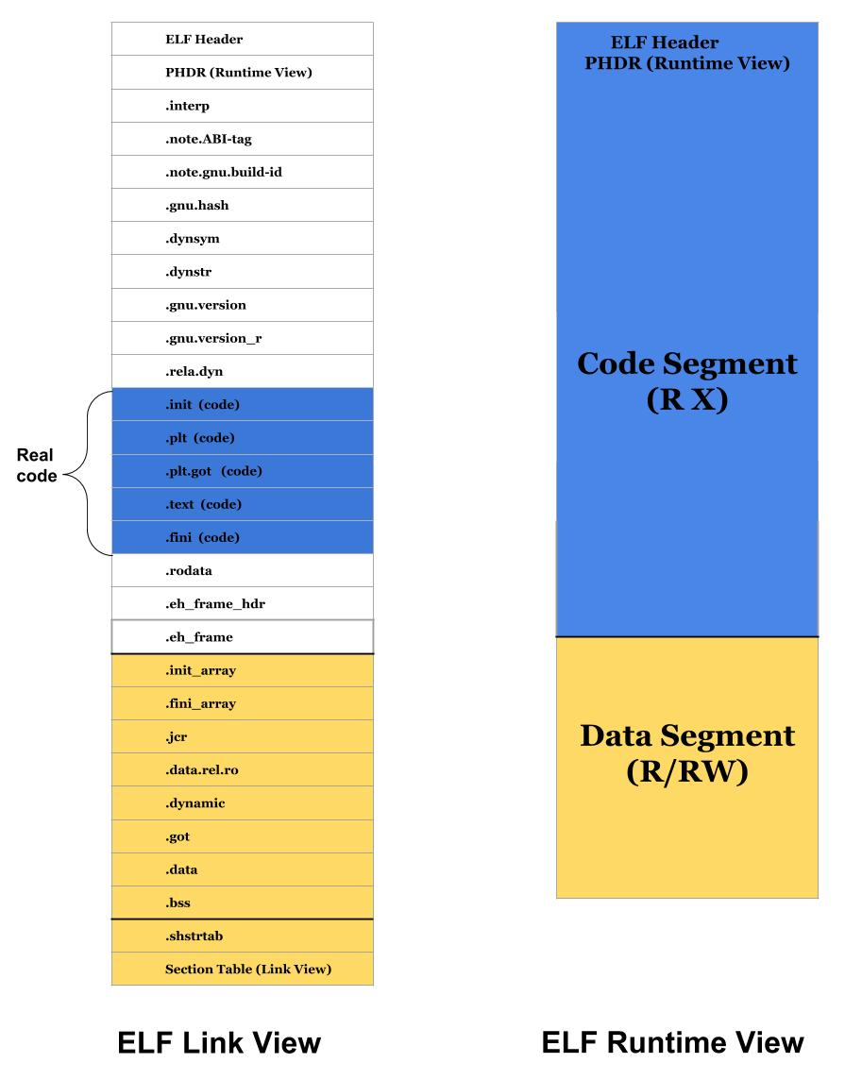
Challenge #1: Code and data mixed in Binary.
ELF has two “views”
ELF header
PHDR
Information is lost from link time to runtime.

Slide 20
Challenge #1: Code and data mixed in Binary.
ELF has two “views”
Runtime code segment mixes:
ELF metadata
Read-only data
Data in the middle of code (jump tables, lookup tables and/or compiler issues).
ELF header
PHDR
We use section table information to discover code pages.
Notes:
We use section table because:
It is generated by compiler and is correct on benign code.
It exists even in stripped ELF binaries.
It is used by debugging tools.
In the future, we could add binary analysis tool for fine grained code page identification.

Slide 21
Challenge #2: Applying Protection Keys on all ELF binaries.
Need to do it at runtime…
executable path is known, but libraries may not be known until runtime.
Need to find the right method/place to hook.
LD_PRELOAD/LD_LIBRARY_PATH: too late
Protection Keys enabling in kernel: cumbersome
Recompiling program loader (ld.so): cumbersome/unstable
recompile the whole glibc libraries.
ld.so incompatible with libc.so.6 in different compilation.
Recompiled glibc may have compatibility issues with other libs (e.g, libstdc++.so.6)
XOM-switch does not require recompilation of glibc or heavyweight binary rewriting

Slide 22
Steps of XOM-Switch:
Develop a binary that inspects ELF structure using C.
Extract out the code/rodata/data of the binary .
Patch the program loader with the extracted code/data.
Inject code at runtime and mark code pages exe only.
ELF header
PHDR
.text
#include <stdio.h>
……
……
……
.rodata
.data
XOM Source Code
XOM Enabling Binary
Program Loader (ld.so)

Slide 23
Steps of XOM-Switch:
Develop a binary that inspects ELF structure using C.
Extract out the code/rodata/data of the binary .
Patch the program loader with the extracted code/data.
Inject code at runtime process and mark code pages exe only.
ELF header
PHDR
.text
.text
#include <stdio.h>
……
……
……
.rodata
.rodata
.data
.data
All relative distance among sections are maintained
XOM Source Code
XOM Enabling Binary
XOM binary piece
Program Loader (ld.so)

Slide 24
Steps of XOM-Switch:
Develop a binary that inspects ELF structure using C.
Extract out the code/rodata/data of the binary.
Patch the program loader with the extracted code/data.
Inject code at runtime process and mark code pages exe only.
ELF header
PHDR
.text
.text
.text
.rodata
.rodata
#include <stdio.h>
……
……
……
.rodata
.data
.data
.data
All relative distance among sections are maintained
.text
.rodata
.data
XOM Source Code
XOM Enabling Binary
XOM binary piece
Program Loader (ld.so)

Slide 25
Steps of XOM-Switch:
Develop a binary that inspects ELF structure using C.
Extract out the code/rodata/data of the binary.
Patch the program loader with the extracted code/data.
Inject code at runtime and mark code pages exe only.
ELF header
PHDR
x
r
rw
.text
Patched locations
#include <stdio.h>
……
……
……
.rodata
Extending PHDR of ld.so with three PT_LOAD segments.
.data
.text
.rodata
.data
XOM Source Code
XOM Enabling Binary
Program Loader (ld.so)
Notes:
Now we complete the job of injecting C code into existing binary.

Slide 26
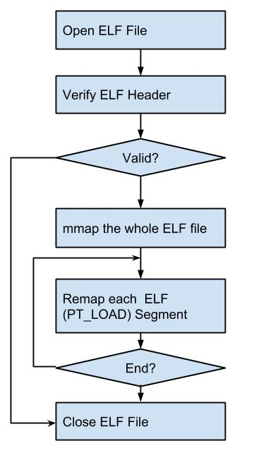
Steps of XOM-Switch:
Inject code at runtime process and mark code pages exe only.
Let’s see the normal ELF binary loading process in glibc:
ELF header
Check file type and compute the total memory needed
PHDR
Code segment
ELF header
x
PHDR
r
rw
Patched locations
The whole memory area is readable and executable
Data segment
Mmap file in random base address
Remap segments starting from 2nd
.text
.rodata
.data
Program Loader (ld.so)

Slide 27
Steps of XOM-Switch:
Injected code at runtime process all ELF loaded and mark code pages exe only.
Now let’s see the modified (patched) ELF binary loading process
ELF header
Section table
PHDR
metadata
x
r
rw
Code segment
(exe only)
Load section table and do analysis
Patched locations
The whole memory area initially is read only
rodata
Map elf metadata as read only
Data segment
mmap whole file as read only
Map code sections as exe only
Map rodata as read only
.text
.rodata
.data
Program Loader (ld.so)
Notes:
According to the “compile time view” provided by section table, we perform more accurate permission setting on different location in code segment.

Slide 28
Challenge #3: Abusing Protection Keys to disable XOM
Attackers may use gadgets that contain wrpkru/xsave to disable XOM!
Intended control flow
malicious control flow
ff 15 0f 01 ef c3 callq *-0x3c10fef1(%rip)
0f 01 ef wrpkru
c3 ret

Slide 29
Challenge #3: Abusing Protection Keys to disable XOM
We could potentially scan the code sections and rewrite dangerous instructions
We could also reset PKRU on each system call.
Ultimate solution: Intel CET. (not immediately available)
ELF header
PHDR
x
metadata
……
r
rw
Code segment
(exe only)
Scan the code sections and rewrite any wrpkru gadgets
Patched locations
The defense is limited in power, but could be helped by CFI/code randomizations.
rodata
Data segment
Map code sections as exe only
Map rodata as read only
.text
.rodata
.data
Code rewritten
Program Loader (ld.so)
Defense #2: Linux kernel: reset PKRU at each system call
Notes:
These two defense mechanisms are for blind-ROP.
Clarify the limitation of Protection Keys against wrpkru abuse.

Slide 30
Evaluation
Cost
Code Size Increase:
ld.so: 7%
libc.so: 0.9% (optional)
Other binaries: 0% (no change)
Code Loading Overhead:
A few extra system calls:
1 mmap and 1 munmap for section table loading
3~5 mprotect for permission changes in code segment

Slide 31
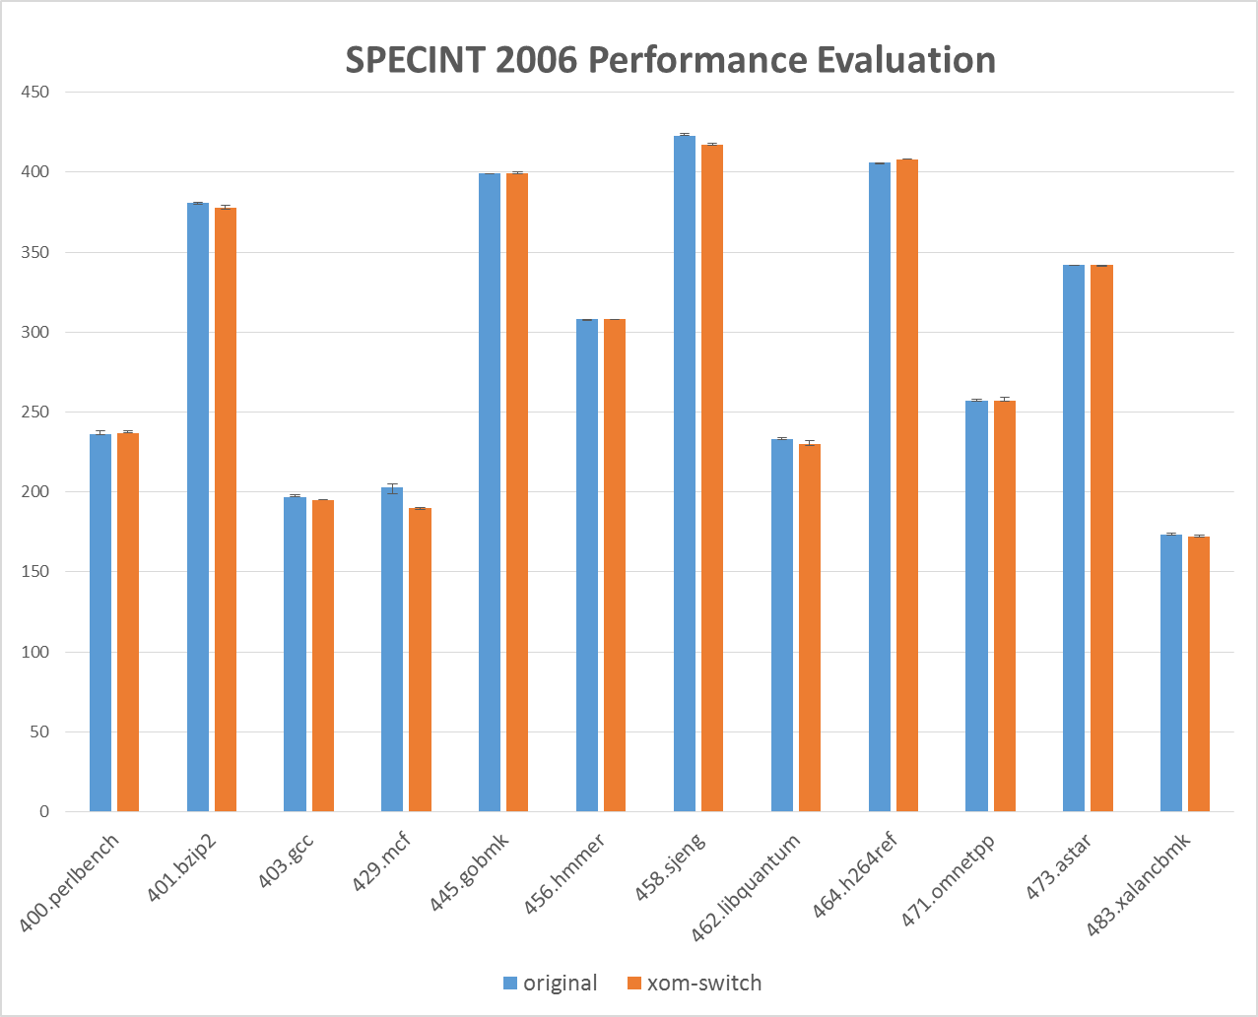
Cost
The average overhead is:
0% (±1%)

Slide 32
Effectiveness
CPU: Intel CPU with Protection Keys enabled
OS: Ubuntu 17.04 with Linux kernel 4.10.0-21-generic
Glibc: glibc-2.24
Application Name | Libraries Loaded | Original Code Size (KB) | XOM enabled Code/Data (KB)
 |  |  | Readable Code | XOM Code | Read-Only “Code” | Total Reduction
Firefox v54 | 130 | 104,032 | 1480 (1.42%) | 60324 (57.98%) | 42228 (40.59%) | 98.57%
soffice.bin (LibreOffice) | 118 | 144,336 | 1360 (.94%) | 66876 (46.33%) | 76100 (52.72%) | 99.05%
Kile | 132 | 101,804 | 1060 (1.04%) | 44624 (43.83%) | 56120 (55.12%) | 98.95%

Slide 33

Effectiveness
1st ROP harvest code pages
2st ROP launch real attack
XOM cannot be read from kernel
0101001110101110
Traditional Code Reuse Attacks
Just-In-Time Code Reuse Attacks
Blind Code Reuse Attacks

Slide 34
XOM-Switch: How to use it

Slide 35
Download the source code
https://github.com/intel/xom-switch.git
Dependency
Make sure you have python 2.7;
Download radare2: https://github.com/radare/radare2.git
Setup radare2 path properly.
Binary patching
Transform your program loader:
src/analysis/patch_loader.sh /lib64/ld-linux-x86-64.so.2 ./your_new_ld.so
sudo cp ./your_new_ld.so /lib64/ld-xom.so
Transform your libc.so (optional):
src/analysis/patch_libc.sh /path/to/your/libc.so.6 ./your_new_libc.so

Slide 36
To Run:
/lib64/ld-xom.so /usr/lib/firefox/firefox
LD_PRELOAD=/path/to/your/libc.so /lib64/ld-xom.so /usr/lib/firefox/firefox
Verify:
Check /proc/your_pid/maps and see memory permission maps

Slide 37
Acknowledgements
Thanks to Ravi Sahita, Deepak Gupta, Michael LeMay, David Durham, Andy Anderson, David Koufaty, Dave Hansen for all the support on this work.
References:
https://software.intel.com/sites/default/files/managed/c5/63/336996-Speculative-Execution-Side-Channel-Mitigations.pdf
https://newsroom.intel.com/wp-content/uploads/sites/11/2018/01/Intel-Analysis-of-Speculative-Execution-Side-Channels.pdf
https://www.kernel.org/doc/Documentation/x86/protection-keys.txt

Slide 38
XOM-SWITCH: Hiding Your Code From Advanced Code Reuse Attacks in One Shot Source code: https://github.com/intel/xom-switch.git Contact: mingwei.zhang@intel.com
Question ?

Slide 39
System Internals and Overcome work…
Transparency Issues
System calls
Modified program loader
Data embedded in the middle of code
Making exceptions: libavcodec.so; libcrypto.so; … (all 4)
Making fine grained policies

